Slide 1


Making Room: Cultivating Communities of Inclusion
Learning, Intellectual, and Physical Disabilities and Your Church: What it is and How to Help
Presenter, Barbara J. Newman
Notes:
Picture with multicolored tint
(Basic)
To reproduce the picture effects on this slide, do the following:
On the Home tab, in the Slides group, click Layout, and then click Blank.
On the Insert tab, in the Illustrations group, click Picture. In the Insert Picture dialog box, select a picture, and then click Insert.
Under Picture Tools, on the Format tab, in the bottom right corner of the Size group, click the Size and Position dialog box launcher. In the Size and Position dialog box, on the Size tab, resize or crop the picture as needed so that under Size and rotate, the Height box is set to 4.08” and the Width box is set to 10”. Resize the picture under Size and rotate by entering values into the Height and Width boxes. Crop the picture under Crop from by entering values into the Left, Right, Top, and Bottom boxes.
Select the picture. On the Home tab, in the bottom right corner of the Drawing group, click the Format Shape dialog box launcher. In the Format Picture dialog box, click Picture in the left pane, and then do the following in the Picture pane:
Click the button next to Recolor, and then under Color Modes, click Grayscale (first option from the left).
In the Brightness box, enter 25%.
In the Contrast box, enter 25%.
Also in the Format Shape dialog box, click Shadow in the left pane. In the Shadow pane, click the button next to Presets, and then under Inner click Inside Top (first row, second option from the left).
On the Home tab, in the Drawing group, click Shapes, and then under Rectangles, click Rectangle (first option from the left). Drag to draw a rectangle on the slide.
Under Drawing Tools, on the Format tab, in the Size group, do the following:
In the Shape Height box, enter 4.08”.
In the Shape Width box, enter 10”.
On the Home tab, in the bottom right corner of the Drawing group, click the Format Shape dialog box launcher. In the Format Shape dialog box, click Fill in the left pane, select Gradient fill in the Fill pane, and then do the following:
Click the button next to Preset colors, and then click Rainbow II (fourth row, second option from the left).
In the Type list, select Linear.
Click the button next to Direction, and then click Linear Left (first row, fifth option from the left).
In the Angle box, enter 180°.
Under Gradient stops, in the drop-down list, select each of the five stops individually, and then in the Transparency box, enter 70%.
Also in the Format Shape dialog box, click Line Color in the left pane, and then select No line in the Line Color pane.
Press and hold SHIFT and select both the picture and the rectangle. On the Home tab, in the Drawing group, click Arrange, and then do the following:
Point to Align, and then click Align to Slide.
Point to Align, and then click Align Middle.
Point to Align, and then click Align Center.
Click Group.
Drag the group vertically on the slide to position as needed.
If the group is no longer centered horizontally on the slide, on the Home tab, in the Drawing group, click Arrange, point to Align, and then do the following:
Click Align to Slide.
Click Align Center.
To reproduce the background on this slide, do the following:
Right-click the slide background area, and then click Format Background. In the Format Background dialog box, click Fill in the left pane, select Gradient fill in the Fill pane, and then do the following:
In the Type list, select Linear.
Click the button next to Direction, and then click Linear Right (first row, fourth option from the left).
In the Angle text box, enter 0⁰.
Under Gradient stops, click Add or Remove until three stops appear in the drop-down list.
Also under Gradient stops, customize the gradient stops that you added as follows:
Select Stop 1 from the list, and then do the following:
In the Stop position box, enter 0%.
Click the button next to Color, then under Theme Colors click White, Background 1, Darker 15% (third row, first option from the left).
Select Stop 2 from the list, and then do the following:
In the Stop position box, enter 20%.
Click the button next to Color, and then under Theme Colors click White, Background 1 (first row, first option from the left).
Select Stop 3 from the list, and then do the following:
In the Stop position box, enter 100%.
Click the button next to Color, and then under Theme Colors click White, Background 1, Darker 25% (fourth row, first option from the left).

Slide 2

Six G.L.U.E. Steps
Step One: Read the Label
Awareness with Leaders
Step Two: Open the G.L.U.E.
Awareness with Others
Step Three: Discover the Possibilities
Getting to know the individual/family and the church
Step Four: Select the Right G.L.U.E.
Develop an Action Plan for individual and others
Step Five: Spread the G.L.U.E.
Share opportunities and provide trainings
Step Six: Secure the Bond
Oversee the process and recognize those involved

Slide 3

Our Lives in Green and Pink

Slide 4
Memory - Learning
Attention
Control
Fuel
Input
0utput
Understanding and Using Words
(Language)
Problem Solving/ Concepts (Higher Order Thinking)
Memory
Short term
Active working
Long term
Understanding & Organizing
What I see (Visual Spatial Ordering)
Keeping Track of:
Time
The order of things
(Temporal-Sequential Ordering)
Muscle and Motor Skill
Fine motor
Gross Motor
Graphomotor
Making and Keeping Friends
(Social Cognition)

Slide 5
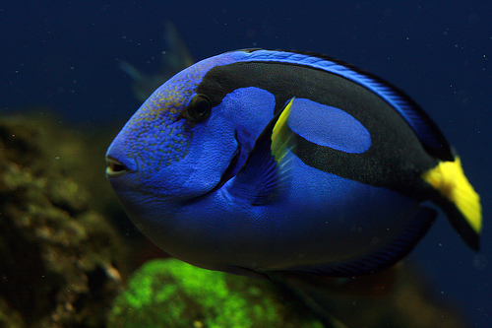

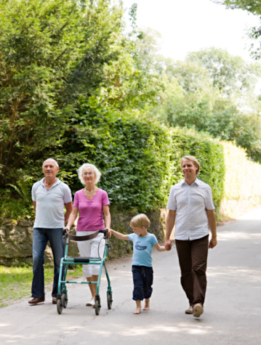
Memory - Learning
John 3:16
For God so loved the world that He gave His only begotten Son, that whoever believes in Him will have eternal life.

Slide 6

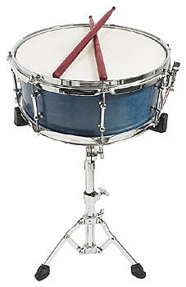
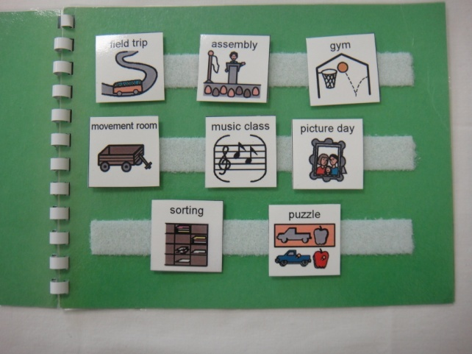
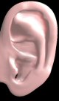

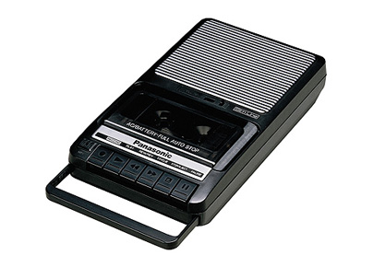
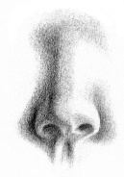



Memory - Learning

Slide 7
What I See - Learning
Attention
Control
Fuel
Input
0utput
Understanding and Using Words
(Language)
Problem Solving/ Concepts (Higher Order Thinking)
Memory
Short term
Active working
Long term
Understanding & Organizing
What I see (Visual Spatial Ordering)
Keeping Track of:
Time
The order of things
(Temporal-Sequential Ordering)
Muscle and Motor Skill
Fine motor
Gross Motor
Graphomotor
Making and Keeping Friends
(Social Cognition)

Slide 8
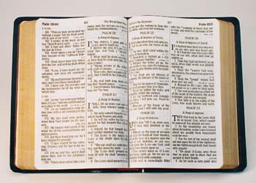

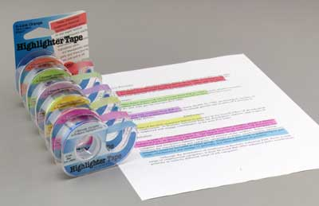
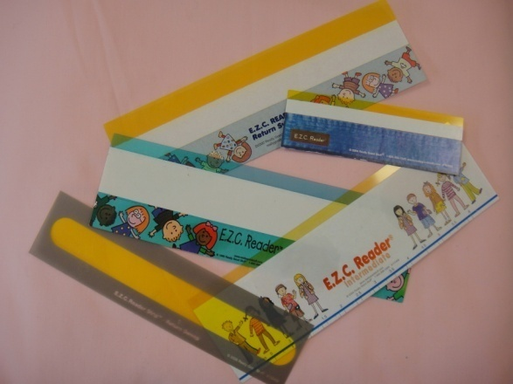
What I See - Learning

Slide 9
Language - Learning
Attention
Control
Fuel
Input
0utput
Understanding and Using Words
(Language)
Problem Solving/ Concepts (Higher Order Thinking)
Memory
Short term
Active working
Long term
Understanding & Organizing
What I see (Visual Spatial Ordering)
Keeping Track of:
Time
The order of things
(Temporal-Sequential Ordering)
Muscle and Motor Skill
Fine motor
Gross Motor
Graphomotor
Making and Keeping Friends
(Social Cognition)

Slide 10


Language - Learning
Say what you WANT the child to do.

Slide 11
Time - Learning
Attention
Control
Fuel
Input
0utput
Understanding and Using Words
(Language)
Problem Solving/ Concepts (Higher Order Thinking)
Memory
Short term
Active working
Long term
Understanding & Organizing
What I see (Visual Spatial Ordering)
Keeping Track of:
Time
The order of things
(Temporal-Sequential Ordering)
Muscle and Motor Skill
Fine motor
Gross Motor
Graphomotor
Making and Keeping Friends
(Social Cognition)

Slide 12
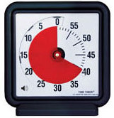
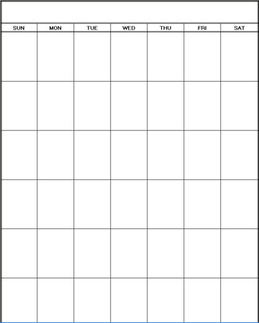
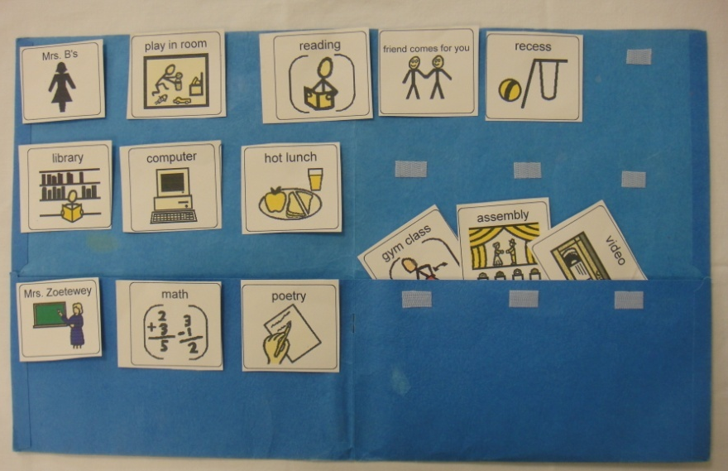
Time - Learning
September

Slide 13
Physical
Attention
Control
Fuel
Input
0utput
Understanding and Using Words
(Language)
Problem Solving/ Concepts (Higher Order Thinking)
Memory
Short term
Active working
Long term
Understanding & Organizing
What I see (Visual Spatial Ordering)
Keeping Track of:
Time
The order of things
(Temporal-Sequential Ordering)
Muscle and Motor Skill
Fine motor
Gross Motor
Graphomotor
Making and Keeping Friends
(Social Cognition)

Slide 14
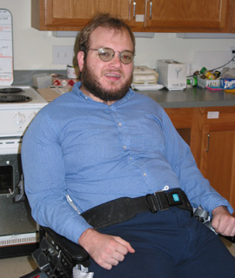

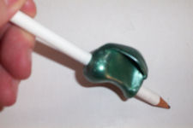
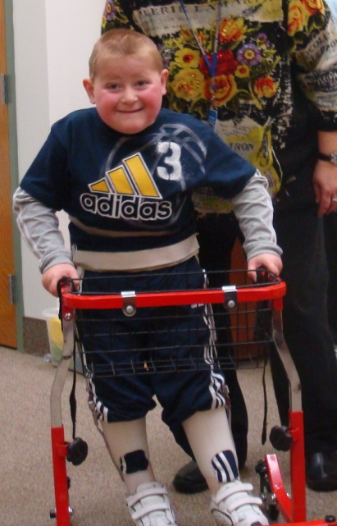
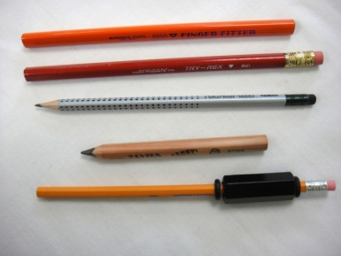
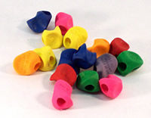
Physical

Slide 15
Intellectual Disabilities
Attention
Control
Fuel
Input
0utput
Understanding and Using Words
(Language)
Problem Solving/ Concepts (Higher Order Thinking)
Memory
Short term
Active working
Long term
Understanding & Organizing
What I see (Visual Spatial Ordering)
Keeping Track of:
Time
The order of things
(Temporal-Sequential Ordering)
Muscle and Motor Skill
Fine motor
Gross Motor
Graphomotor
Making and Keeping Friends
(Social Cognition)

Slide 16
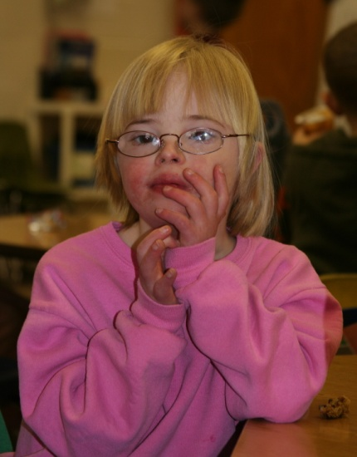

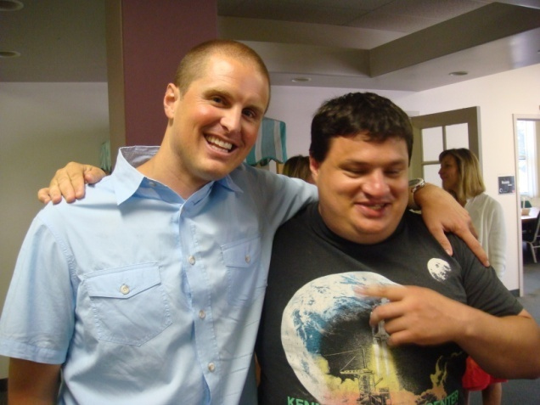

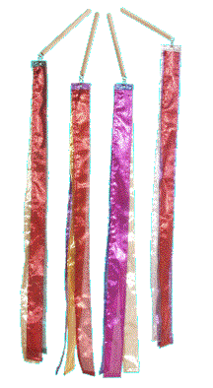
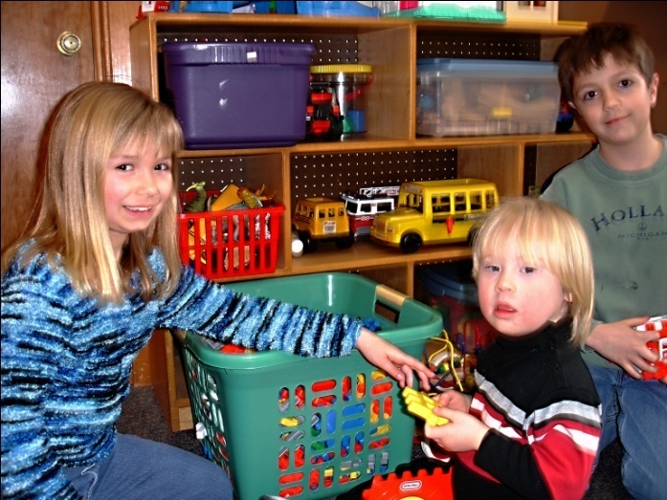
Intellectual Disabilities
Story Stick
&
Story Apron

Slide 17
“The Mind That is Mine”
Attention
Control
Fuel
Input
0utput
Understanding and Using Words
(Language)
Problem Solving/ Concepts (Higher Order Thinking)
Memory
Short term
Active working
Long term
Understanding & Organizing
What I see (Visual Spatial Ordering)
Keeping Track of:
Time
The order of things
(Temporal-Sequential Ordering)
Muscle and Motor Skill
Fine motor
Gross Motor
Graphomotor
Making and Keeping Friends
(Social Cognition)

Slide 18

“The Heart That is Mine”
Feeling Awareness
Empathy for others
Sensitivity - self
Kind hearted
Control- Power
Confidence
Competence
Problem Solving/ Concepts (Higher Order Thinking)
Relationship Building
Connecting to Others
Sense of Belonging
Temperament
Adaptability
Disposition
Intensity
Self Control
Attitude
Emotion
Personal responsibility
Initiative
Personal Worth
Sense their value
Sense their uniqueness
Coping Tools
Fight
Flight
Submit

Slide 19

Everybody Belongs – Everybody Serves

